Slide 1
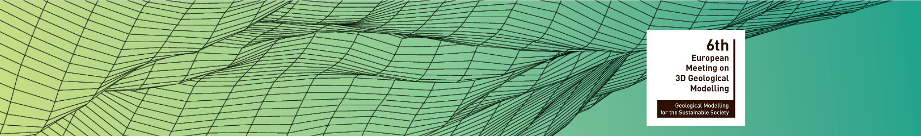


6th European Meeting on 3D Geological Modelling
“Geological modelling for the sustainable society”
Copenhagen, Denmark
23 May – 26 May 2023
Update on the development of tools for transferring boreholes data
and 3D geomodels using the RESQML v2.2 format.
Jean-Marie LEONARD
Valentin GAUTHIER
Priscillia LABOURG
Jean-François RAINAUD

Slide 2


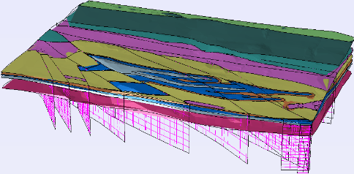

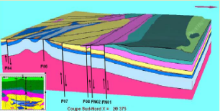
What we presented at the 5th European Meeting (Bern, 2019)
What is most important in my presentation is not the software that I am going to show you, but …. what you could develop for your needs thanks to the RESQML v2.2 format !
The EGIS solution of interoperability between GDM-MultiLayer and Autodesk Civil 3D :
  We use GDM-MultiLayer (BRGM) because it is cheaper than GoCAD, Petrel, EarthVision and it is well adapted for our projects of civil engineering but it cannot export in RESQML format.
  We developed RESQML-Builder. It converts the boreholes data contained in the Excel file used by GDM-MultiLayer and the 3D geomodels produced by GDM-MultiLayer and it writes a pair of files in RESQML format.
RESQML Builder
Autodesk
Civil-3D
Other BIM Softwares
(Navisworks, Infraworks)
RESQML v2.2
RESQMLCAD
Boreholes
Data
GDM 3D Model
EPC +
HDF5
DWG 2018 files
GDM-Multilayer
(BRGM geomodeller)
RESQML-CAD is an add-in. It reads the RESQML files and draws the boreholes and the geomodels in 3D in the DWG files.

Slide 3


What we presented at the 5th European Meeting (Bern, 2019)
The RESQML v2.2 format (Energistics)
The metadata and the numerical data are separated in two files :
  The EPC (*.epc) file: EPC= Energistics Packaging Conventions
  It is an archive (as a zip file) containing two kinds of XML files:
        TopLevelElement files : Each file contains the metadata of an element of the conceptual data model that describes a geomodel or a borehole. Each TopLevelElement is identified by a UUID (Universal Unique Identifier) and represents an object of type Feature, Interpretation, Representation or Property.
        Relation files : they describe the relation between two TopLevelElements. Classically we have :
        Properties n → 1 Representations n → 1 Interpretations n → 1 Feature
  The HDF5 (*.h5) file : HDF5 = Hierarchical data Format, version 5
  It a structured binary file allowing to store the numerical data such as:
        Coordinates (X,Y,Z) of points, summits of triangles composing a TIN,
        Values of measures : Log data (pressuremeter, gamma-ray, etc.), Material data (density, porosity, etc)
➔ Conceptual model of data with a high level of semantics
➔ Storage of high-resolution large-scale 3D models of different types (geological, geotechnical, etc.).
➔ RESQML is a Free and Open format. There are free libraries for developers in C++, Java, C#.NET, Python.
➔ RESQML v2.2 allows us to keep the colors chosen for each formation and borehole intervals between 2 apps.

Slide 4
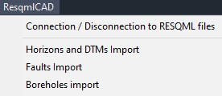
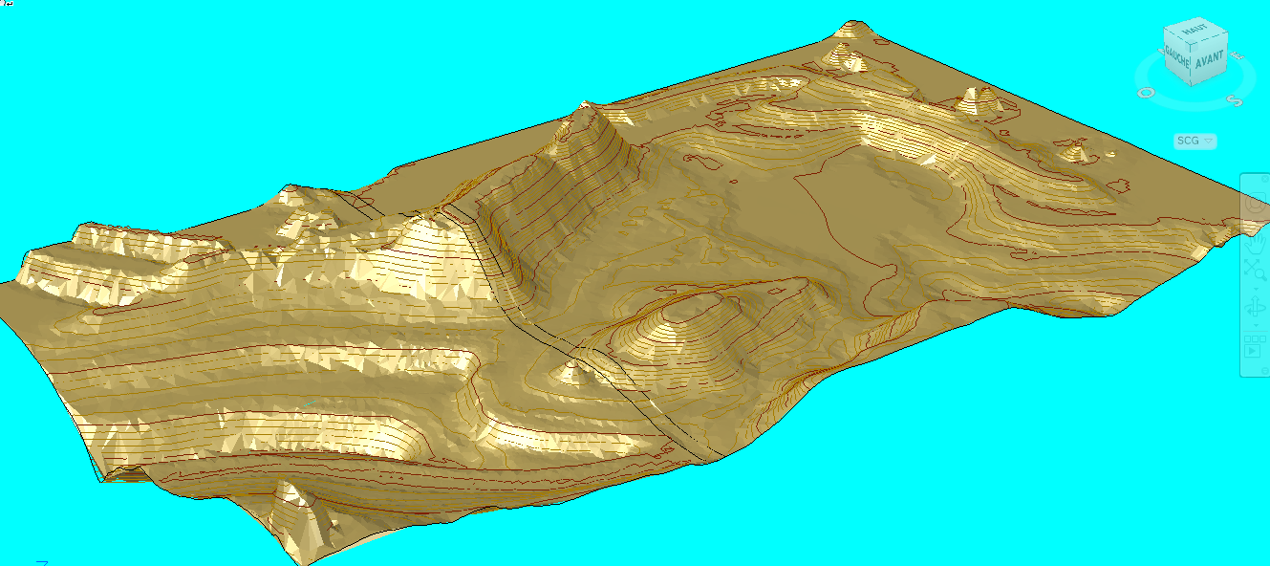
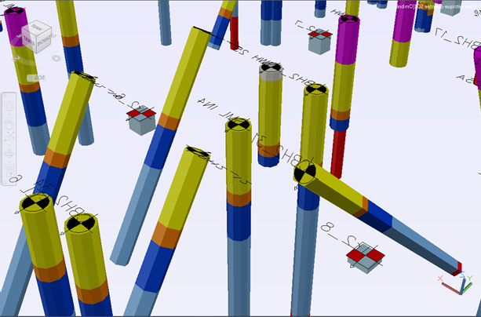
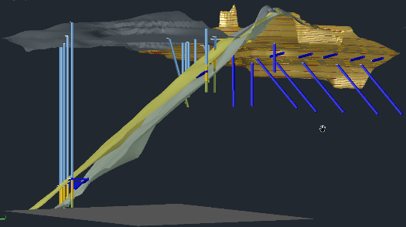
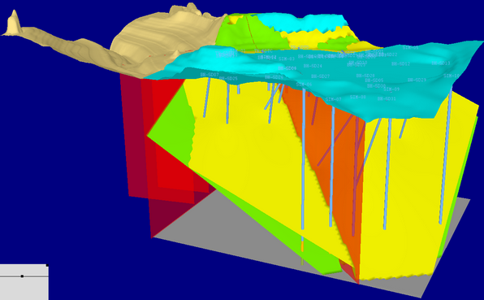
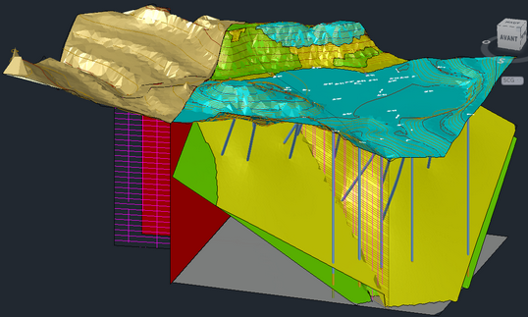
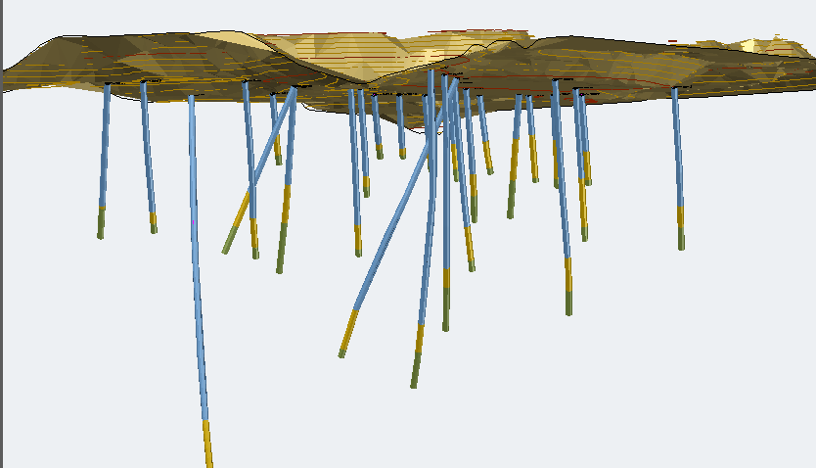
What we presented at the 5th European Meeting (Bern, 2019)
The basic functions
RESQML
RESQML Builder
RESQML CAD
CIVIL 3D drawing
GDM 3D Model

Slide 5
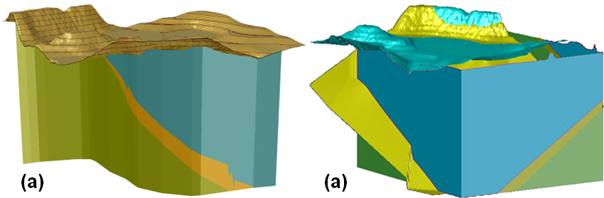
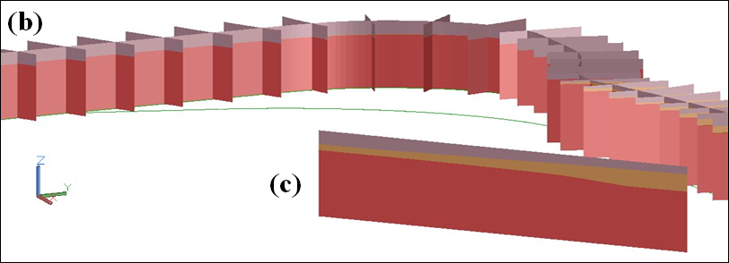
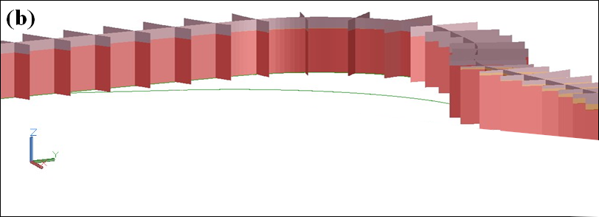
New advanced functionalities of RESQML-CAD
Add Fence Diagrams:
Fence diagrams can be drawn directly from the RESQML file in several ways :
  (a) Following the path of a polyline which can surround a model
  (b) Following the axis and / or the transversal cross-sections of a linear infrastructure (motorway, railway, etc.)
  (c) Following the line created between 2 points on the drawing

Slide 6
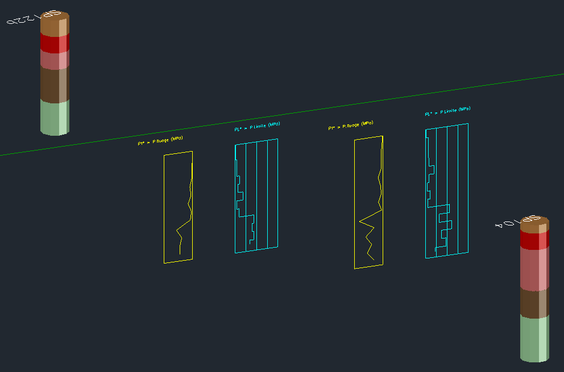
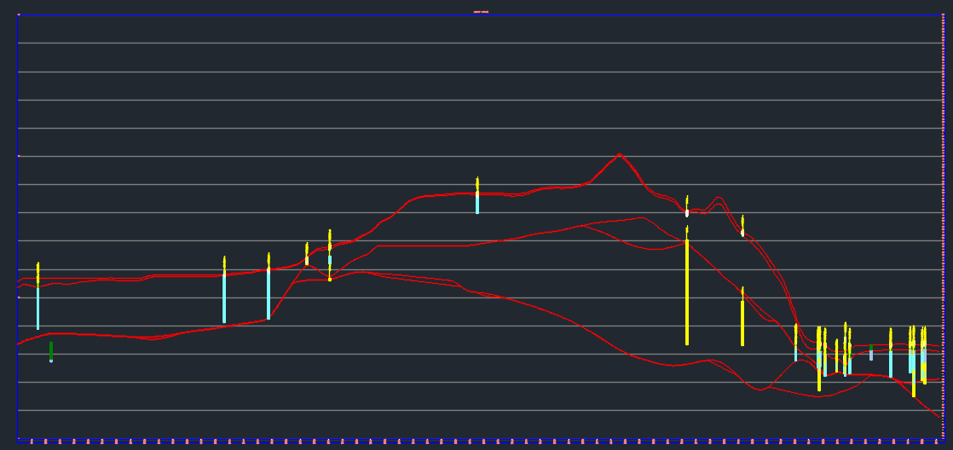
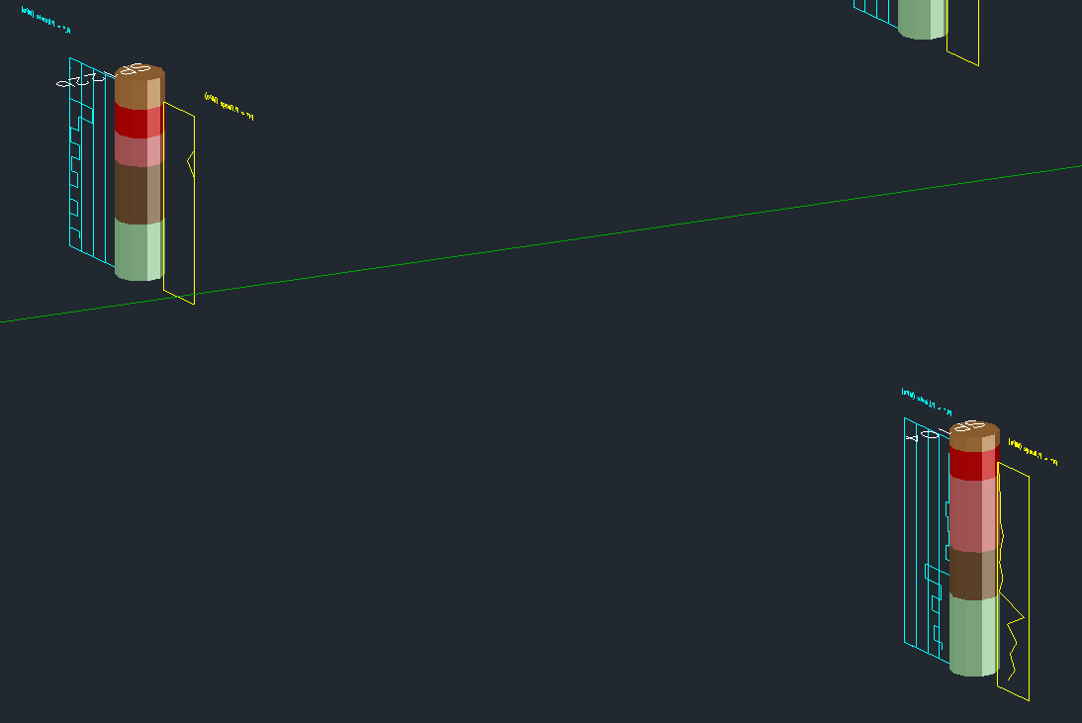
New advanced functionalities of RESQML-CAD
Add borehole logs in 3D:
Drawn belong the boreholes, either parallel to the axis of an infrastructure or parallel to its cross-sections
The curves of the different groups of measures (pressuremeter logs, gamma-ray, etc.) are drawn in different graphical layers
The draftman can project the 3D logs data and the boreholes for drawing the 2D longitudinal view and the 2D transversal cross sections need for the earthworks plans
Guadeloupe Harbour expansion
3D Geotechnical Model

Slide 7
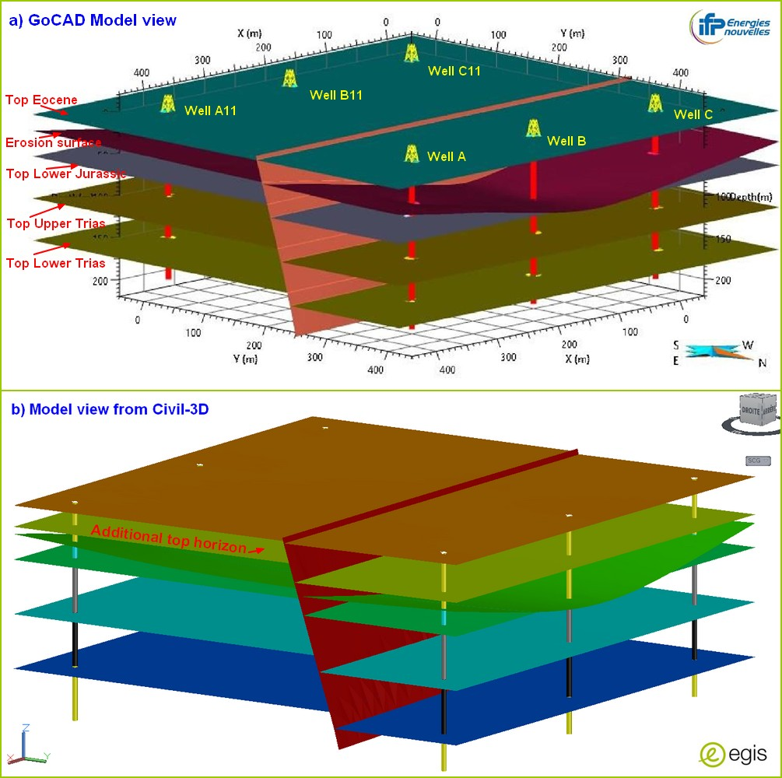
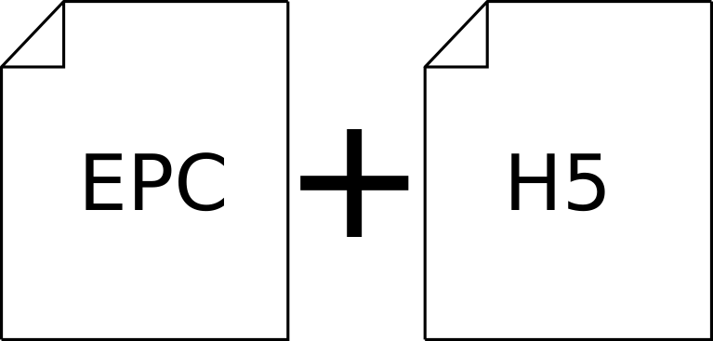
Experiment of a Transfer from GoCAD to Autodesk Civil-3D
GoCAD
RESQML Converter
Migration 2.0.1 to 2.2
RESQML WebStudio
Manually add attributes
+ color info and validation
Civil-3D +
RESQML-CAD
GoCAD Model delivered by IFP Energies nouvelles

Slide 8

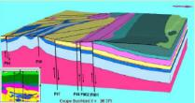
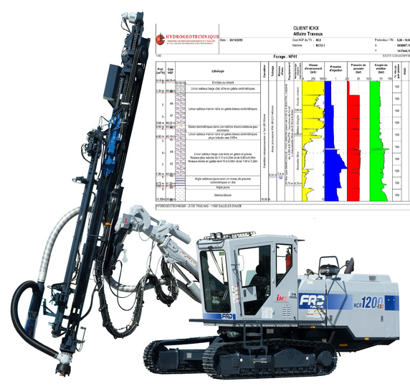
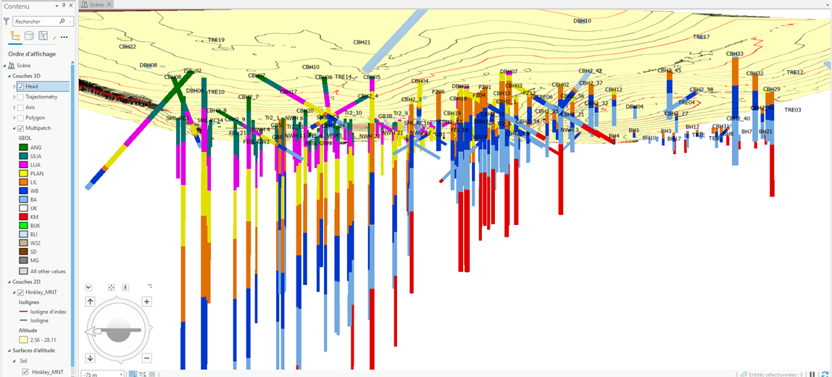
Other developments in progress
RESQML Builder
Autodesk
Civil-3D
Other BIM Softwares
(Navisworks, Infraworks)
RESQML v2.2
RESQMLCAD
Boreholes
Data
GDM 3D Model
EPC +
HDF5
DWG 2018 files
ARCGIS
PRO
RESQML
GIS
ESRI
WebSIG
GDM-Multilayer
(BRGM geomodeller)
ARPX, Geodatabases
EXGTE
(Jean LUTZ SA)
QGIS
Development of an add-in for ArcGIS Pro
The 3D models and boreholes data of the RESQML files already available for Civil-3D can be imported under ArcGIS-Pro
Boreholes data from a drilling software:
Results of campaign are directly available for the BIM and GIS

Slide 9

Import of boreholes under ArcGIS Pro with RESQML-GIS
Vertical and inclined boreholes of the Hinkley Point EPR project (UK). The DTM comes from a LandXML import

Slide 10
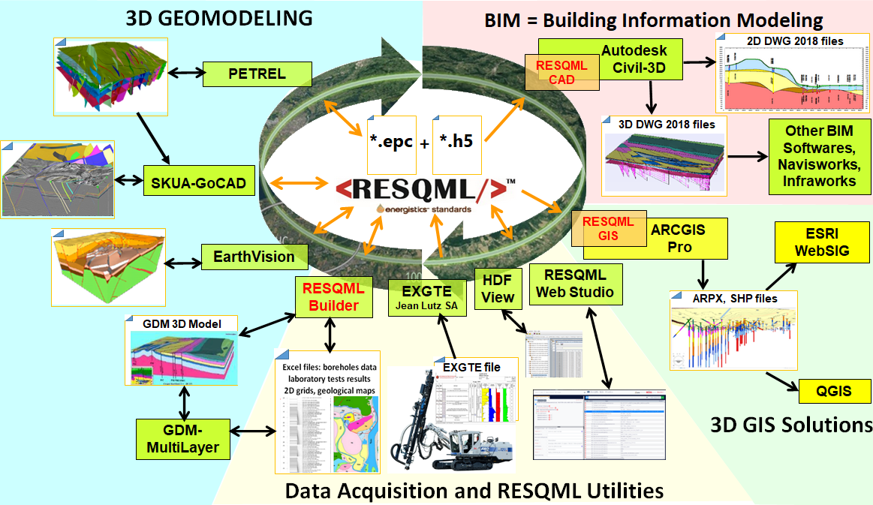
Conclusion : towards a set of RESQML applis working together
  Final Release of v2.2 issued in March 2022
  future upgrades of Petrel, GoCAD, EarthVision, etc.
  With the transfer tools for BIM & GIS applis
  → A set of applications that work together for the digital twins building.
  Energistics is now an af-filiate of the Open Group®, a global consortium that enables the achievement of business objectives through technology standards
  → Integration of RESQML in the OSDU™ platform
  (Open source, cloud-native, subsurface reference architecture).
Organization of tools for the study of FCC (Future Circular Collider) of the CERN at Geneva (Switzerland)

Slide 11
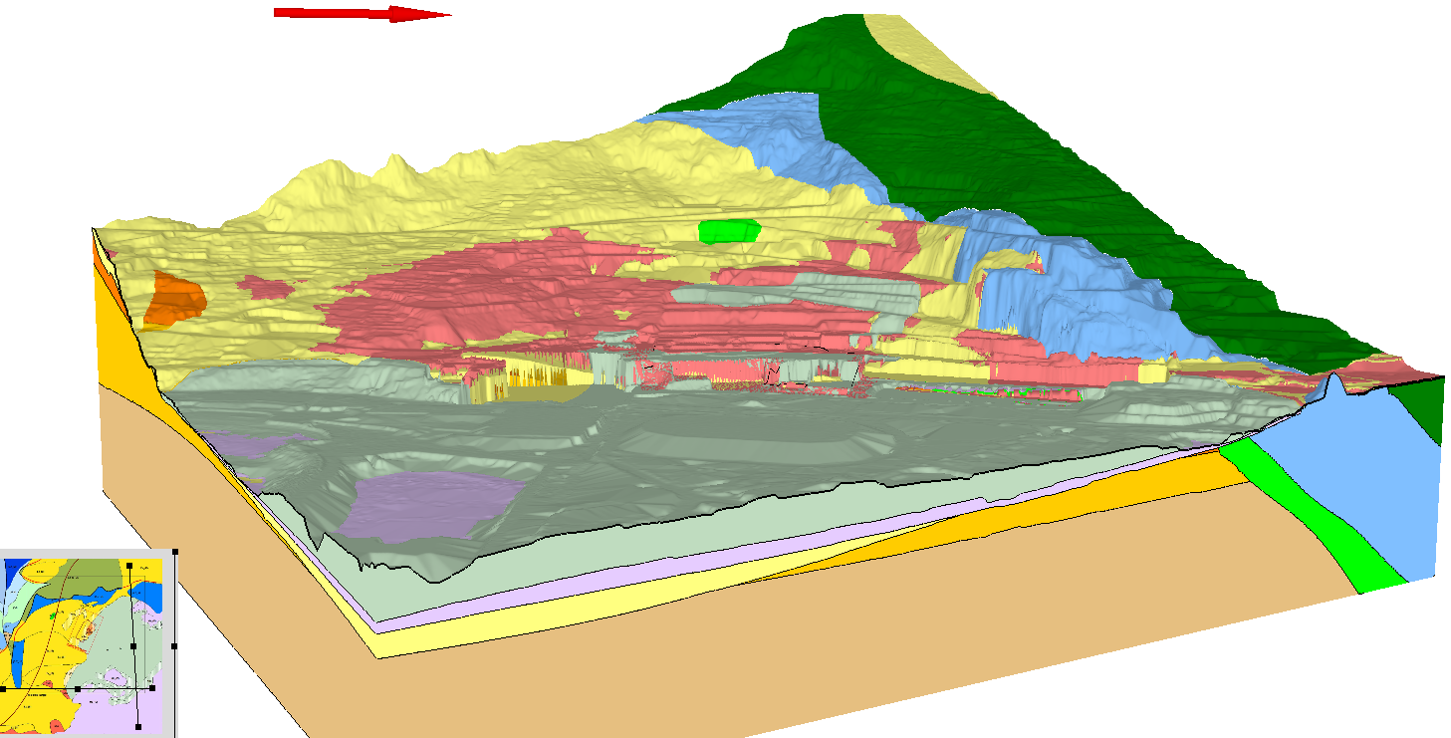
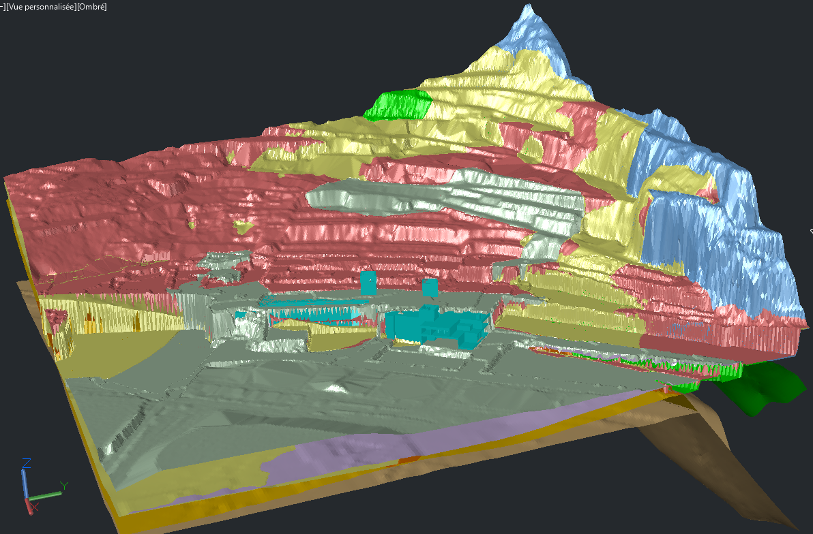
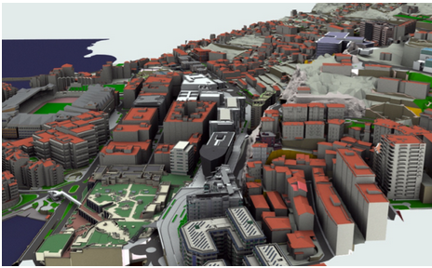
Demos of EGIS tools : RESQML-CAD and RESQML-GIS
Thank you for your attention
Jean-Marie.Leonard@egis-group.com
Tel : +33 (0) 635 128 196
  DEMOs of RESQML-CAD
  3D Geomodels Import
  Boreholes Import
  Add Fence Diagrams
  DEMOs of RESQML-GIS
  → Boreholes Import
  The content of the RESQML files
  Explore the EPC file
  Find the data contained in the HDF5 file for any element of the EPC file.
The authors address their thanks to all the team which organized this 6th European Meeting on 3D Geomodelling
  3D geotechnical model of the Ilot Charles III, Monaco.

